Slide 1
Web .config file in
ASP.NET

Slide 2
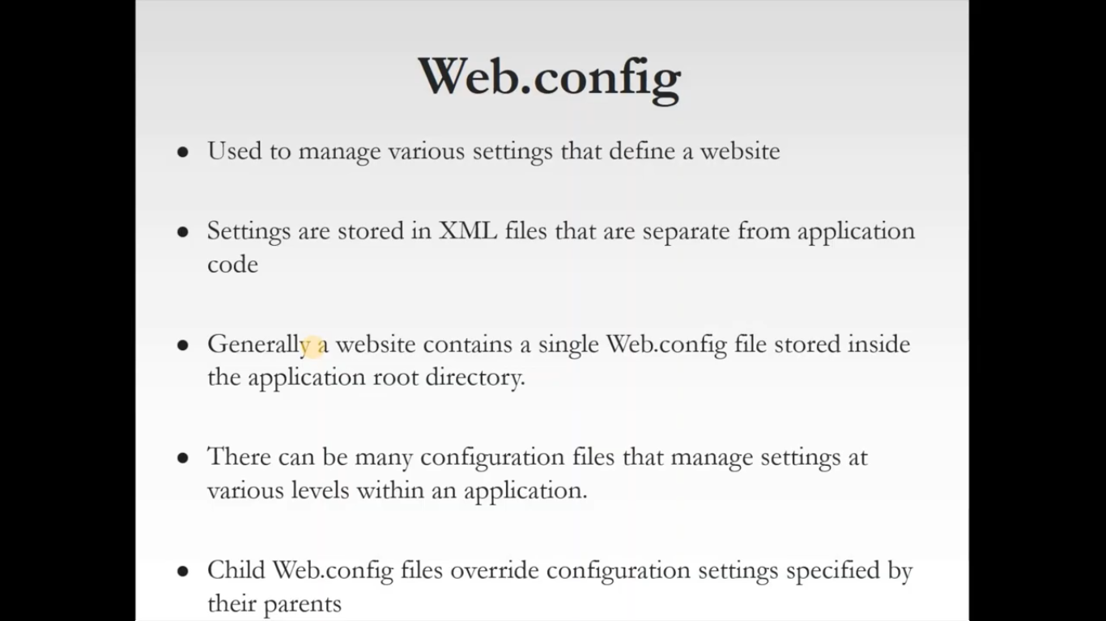

Slide 3
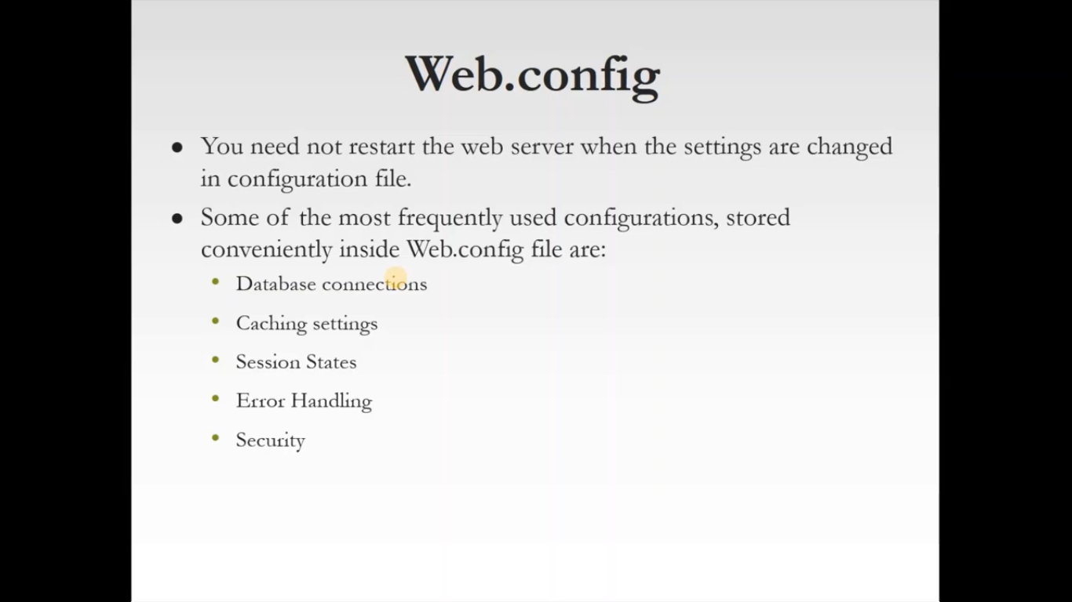

Slide 4
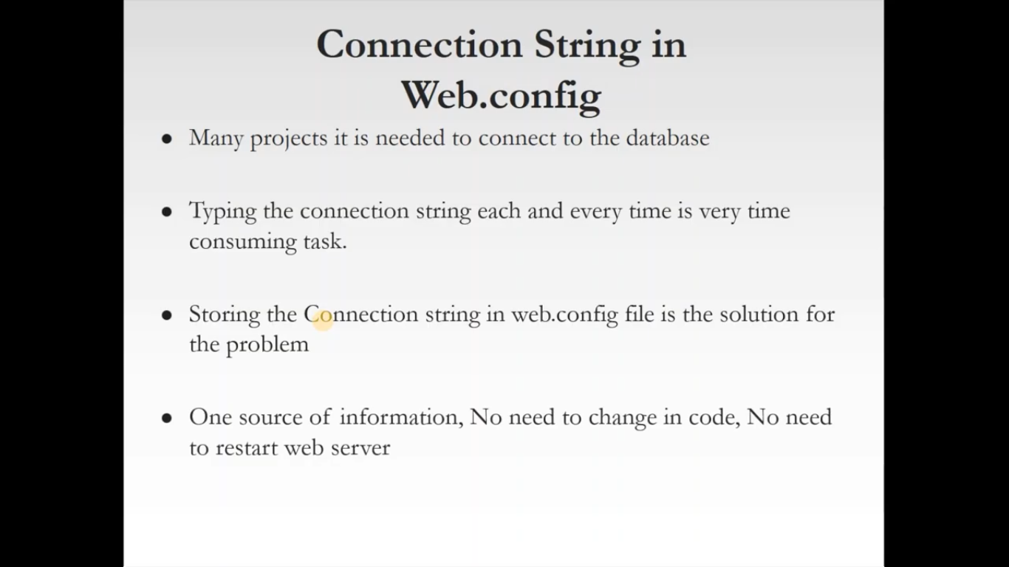

Slide 5
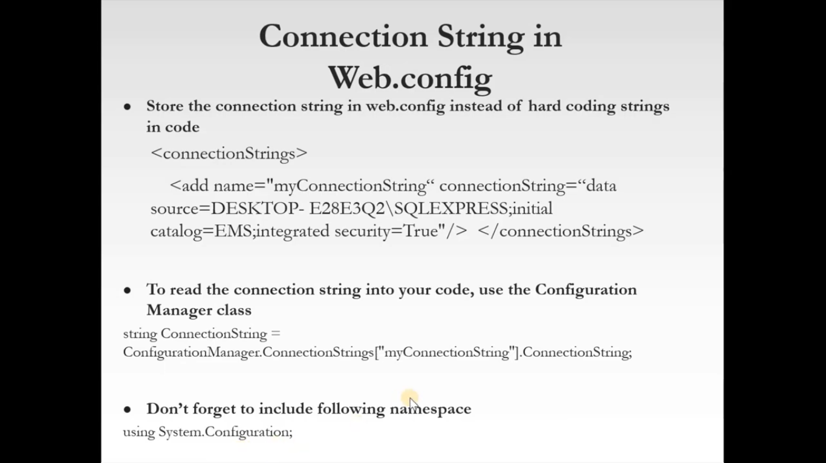

Slide 6
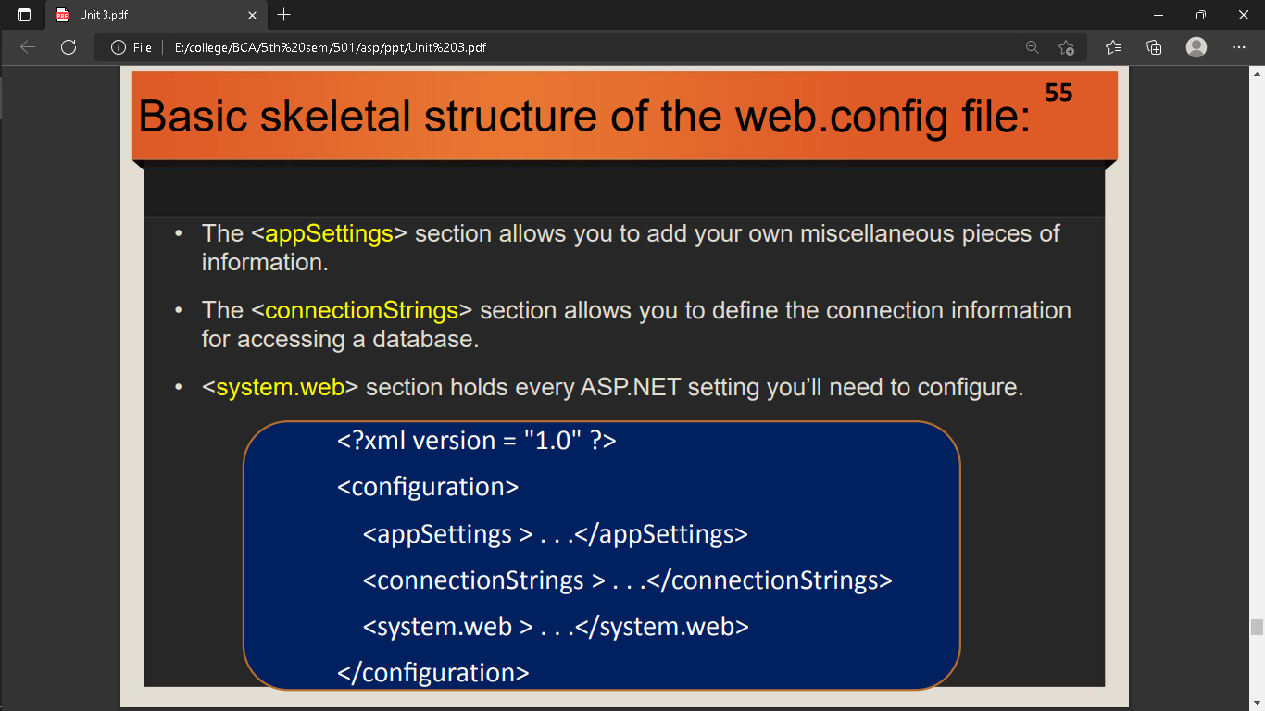

Slide 7
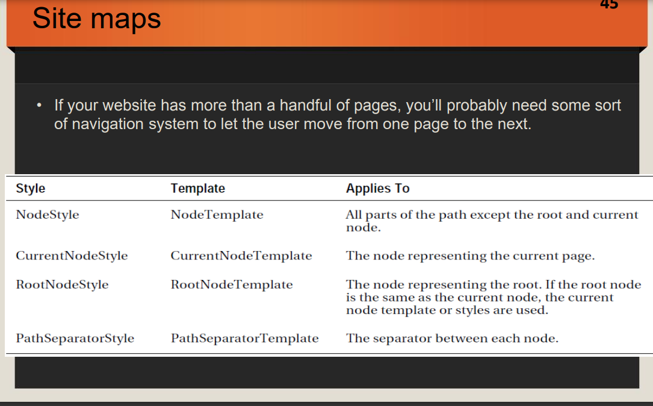

Slide 8
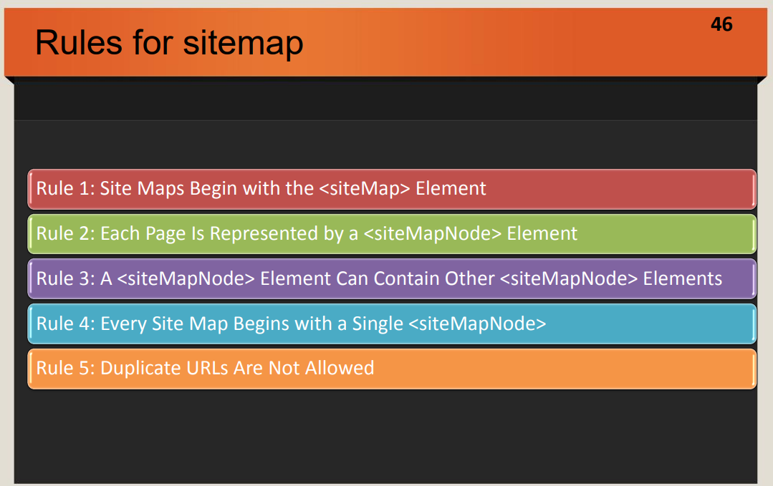

Slide 9
Introduction To SiteMapPath
The SiteMapPath control basically is used to access web pages of the website from one webpage to another.
It is a navigation control and displays the map of the site related to its web pages.
This map includes the pages in the particular website and displays the name of those pages.
You can click on that particular page in the Site Map to navigate to that page.
We can say that the SiteMapPath control displays links for connecting to URLs of other pages.
The SiteMapPath control uses a property called SiteMapProvider for accessing data from databases and it stores the information in a data source.
The SiteMapProvider internally utilizes the SiteMapProvider abstract class defined under the System.Web namespace.
The representation of the SiteMapPath control is as follows:
Root Node->Child Node

Slide 10
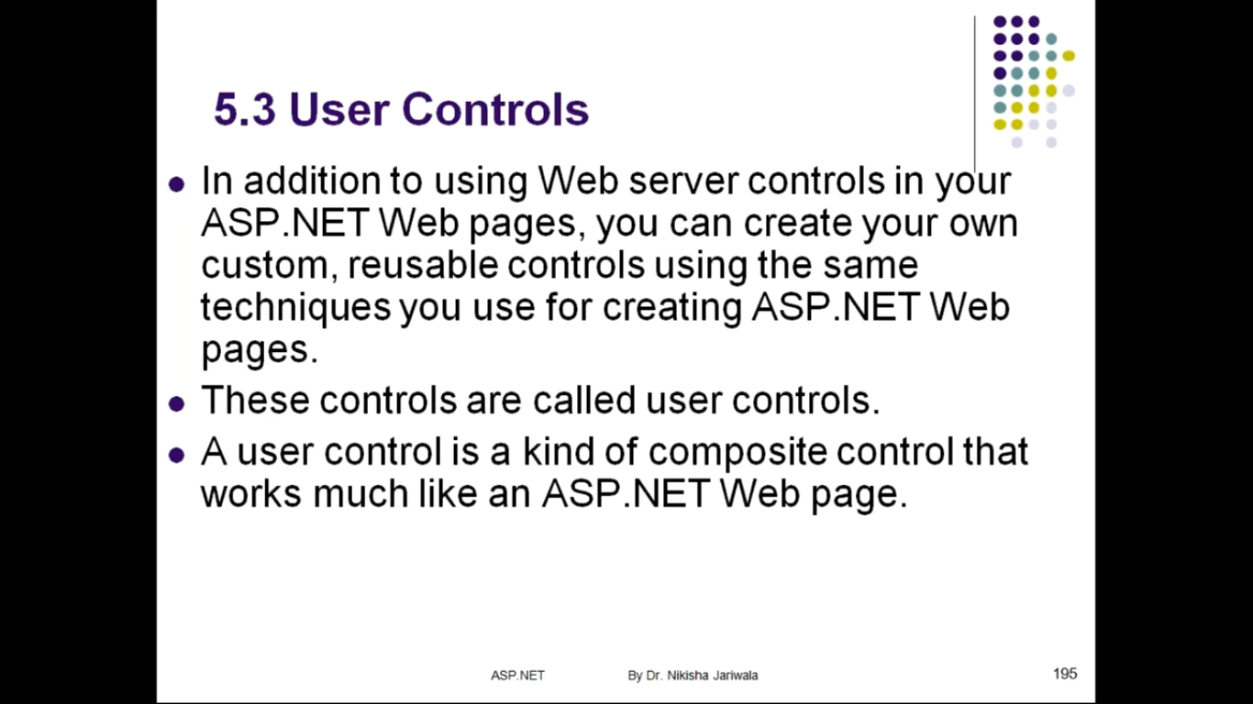

Slide 11
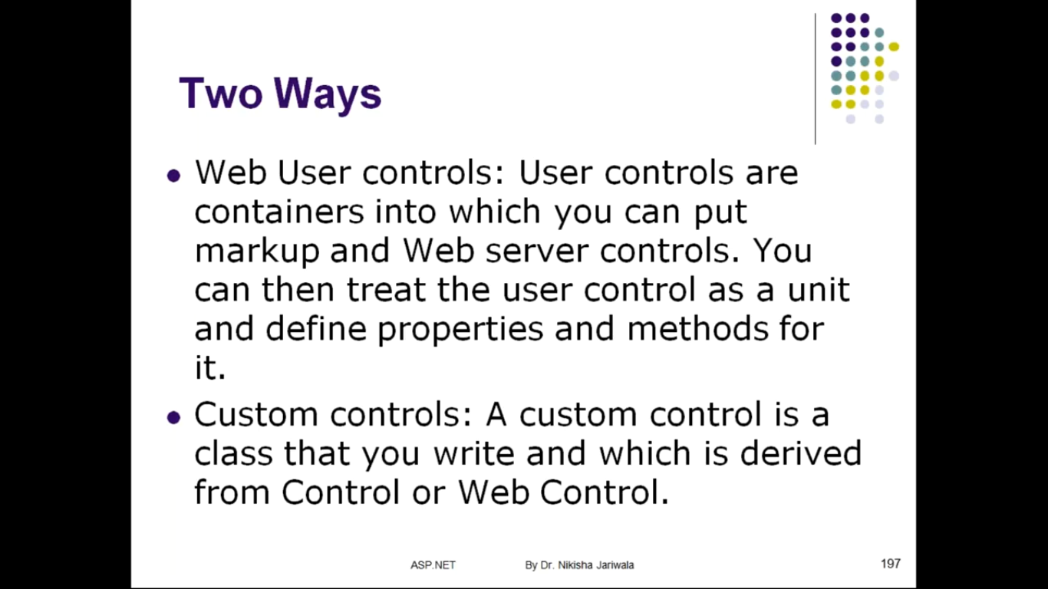

Slide 12
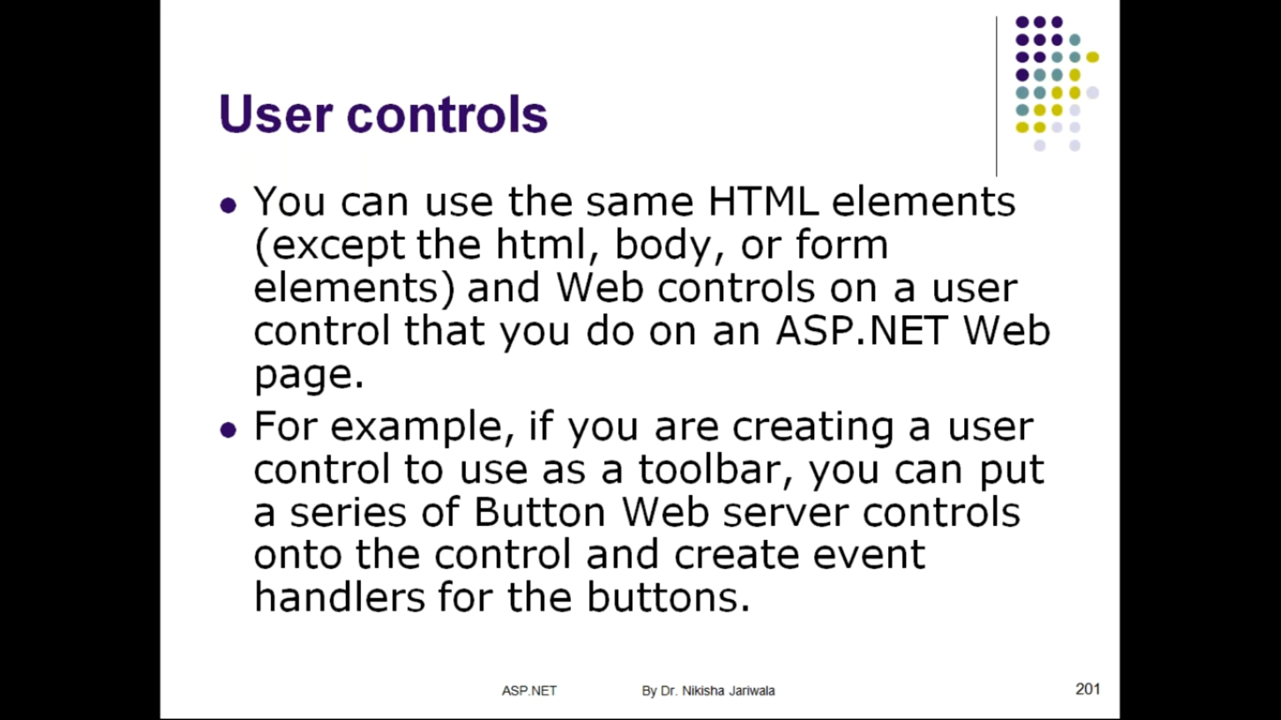

Slide 13
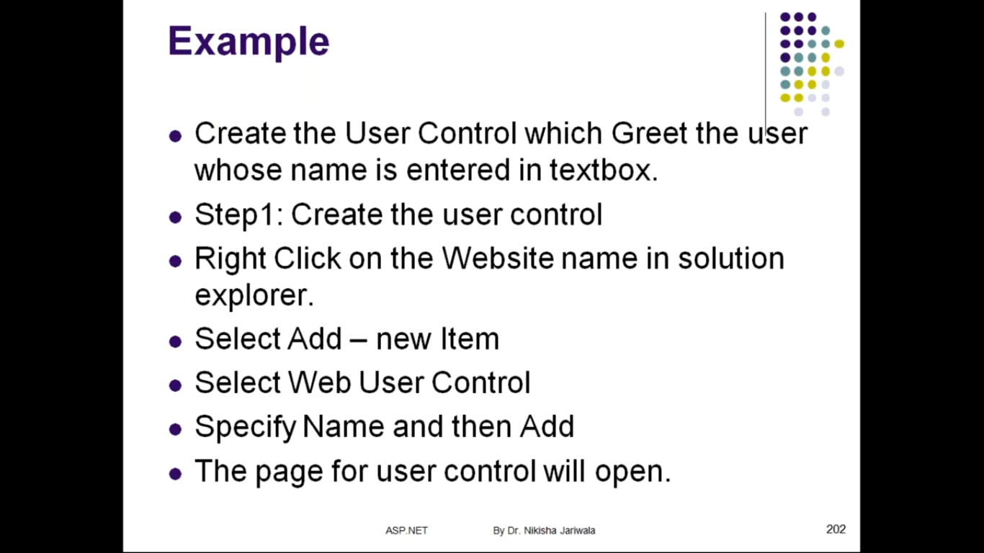

Slide 14
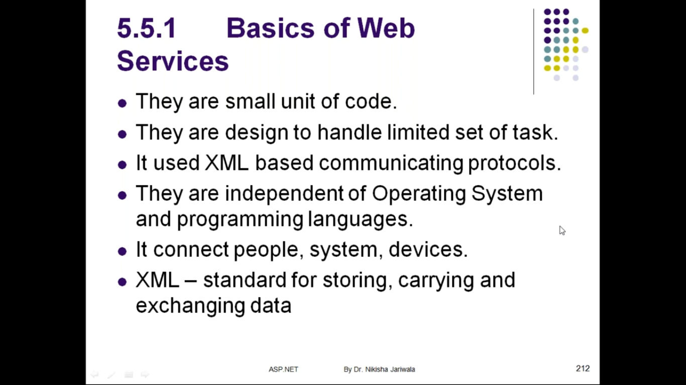

Slide 15
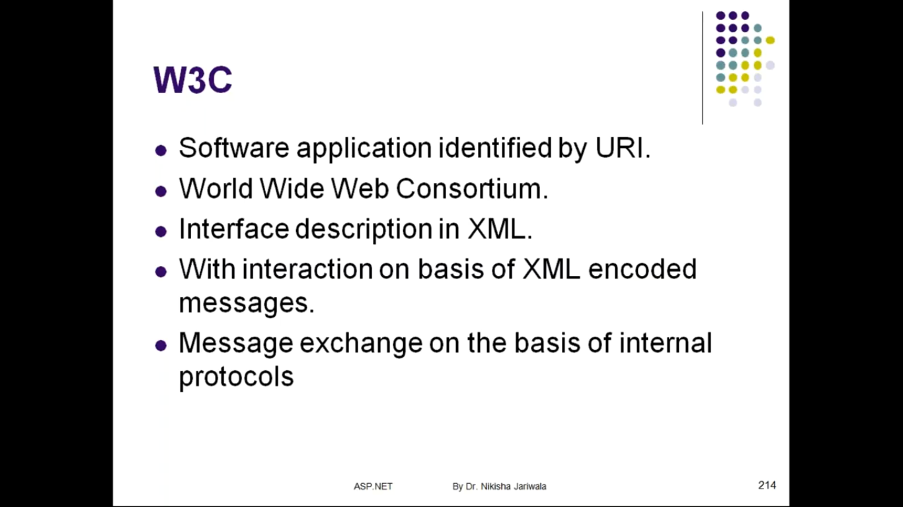

Slide 16
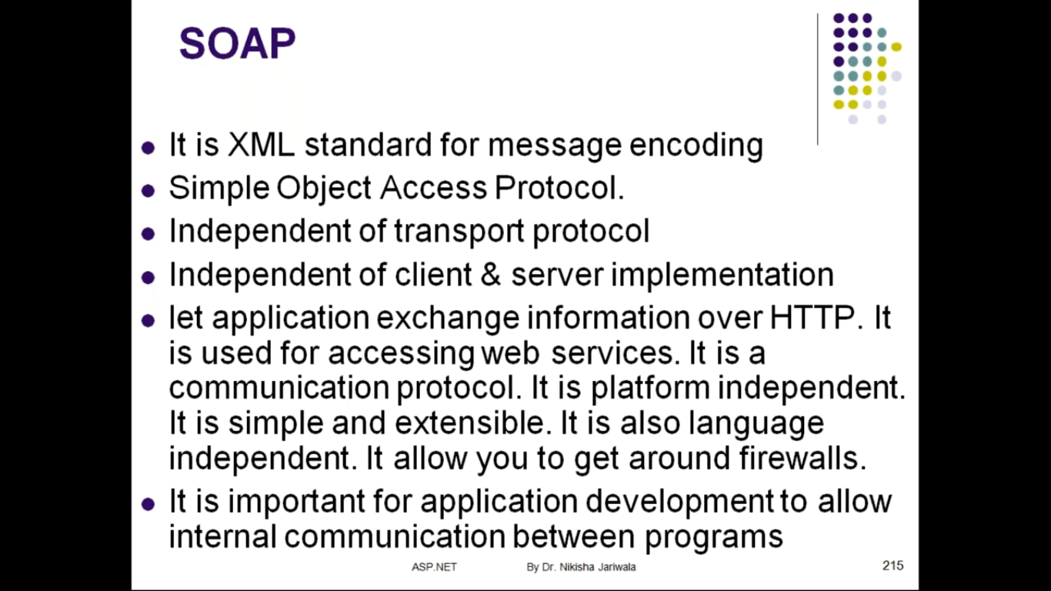

Slide 17
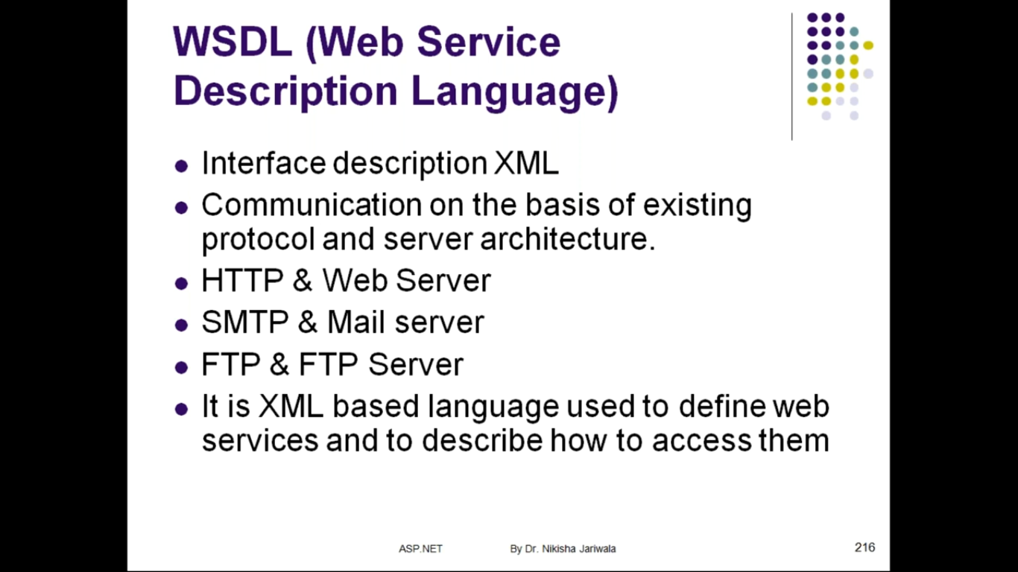

Slide 18
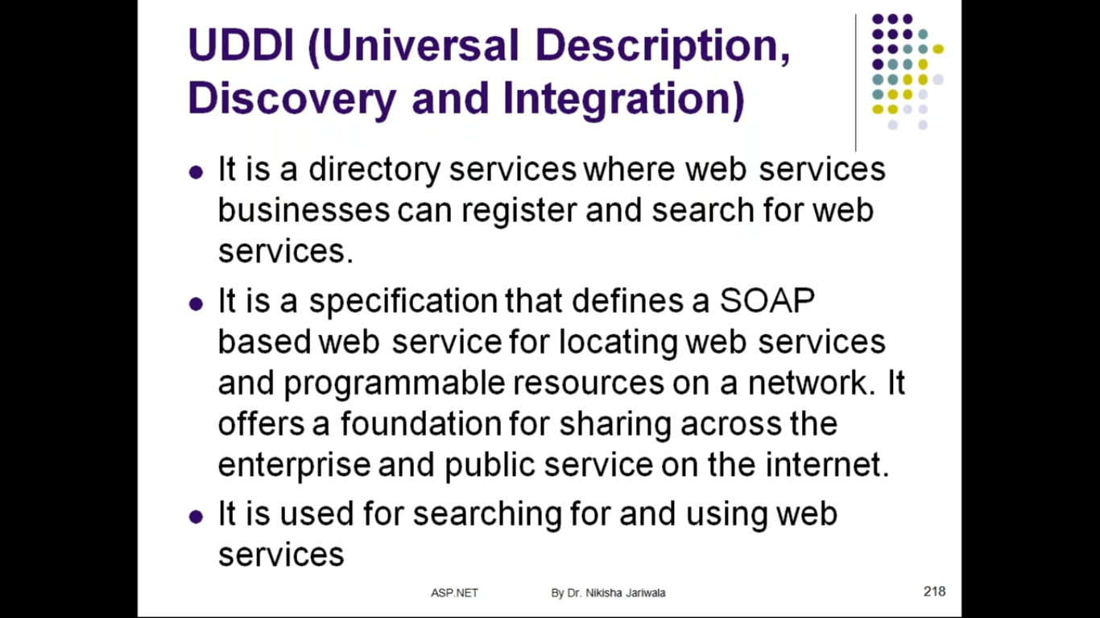

Slide 19
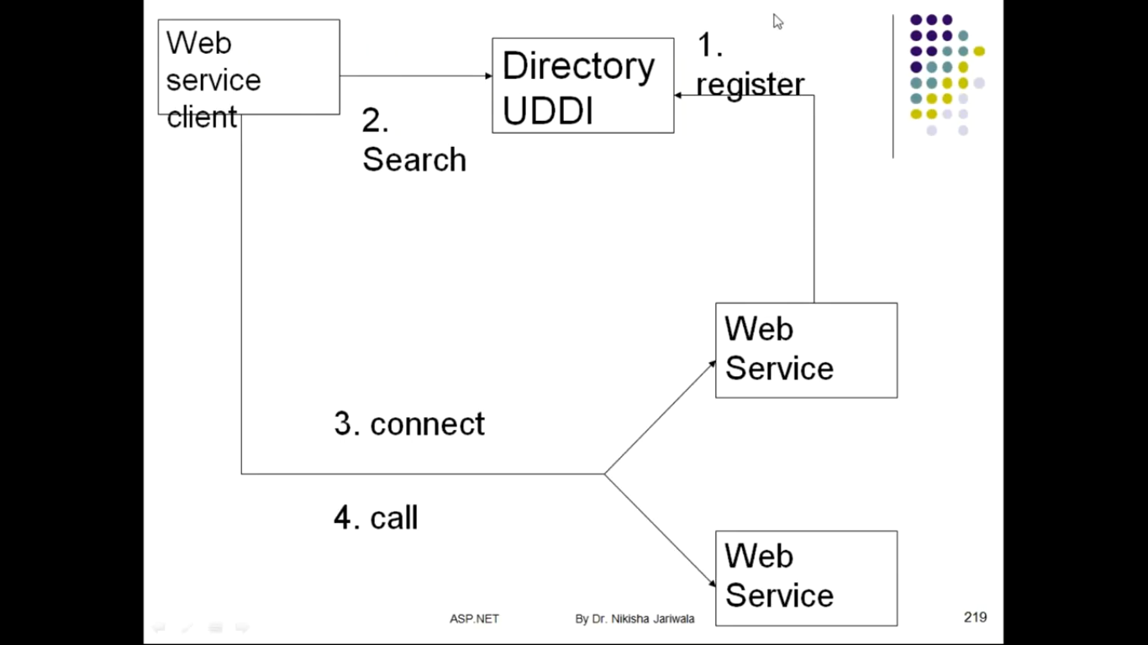

Slide 20
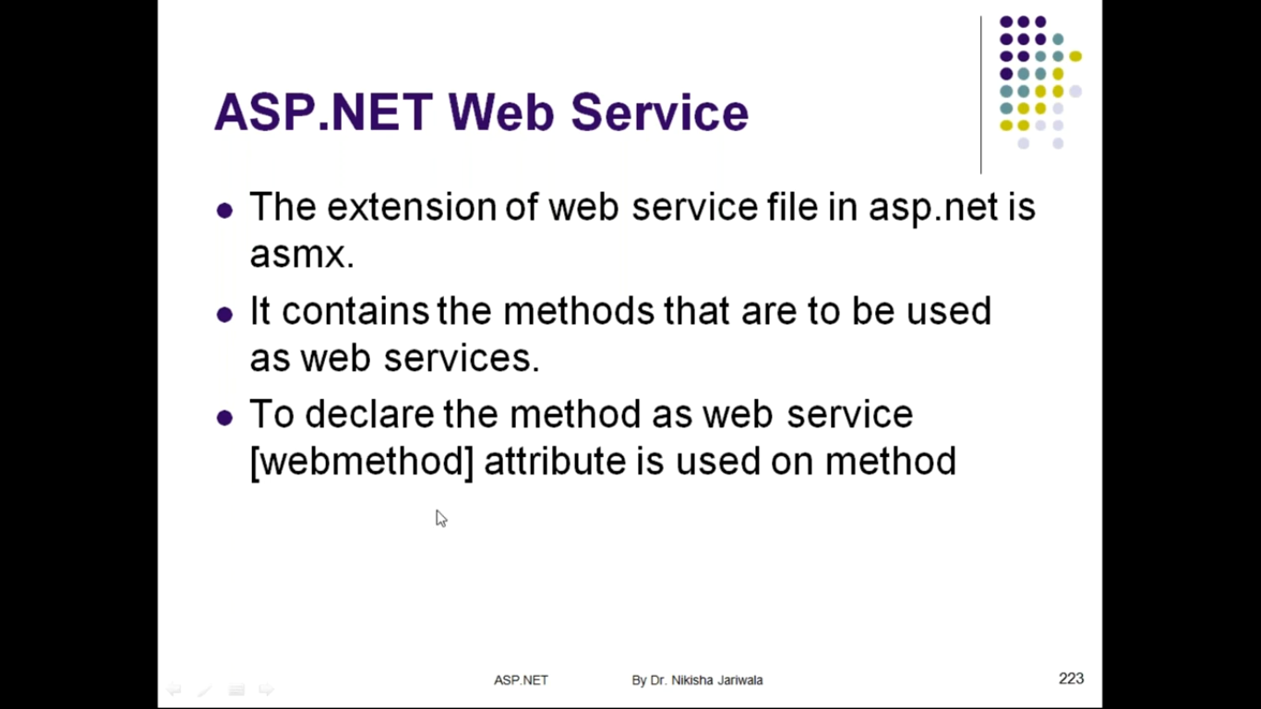

Slide 21


Slide 22
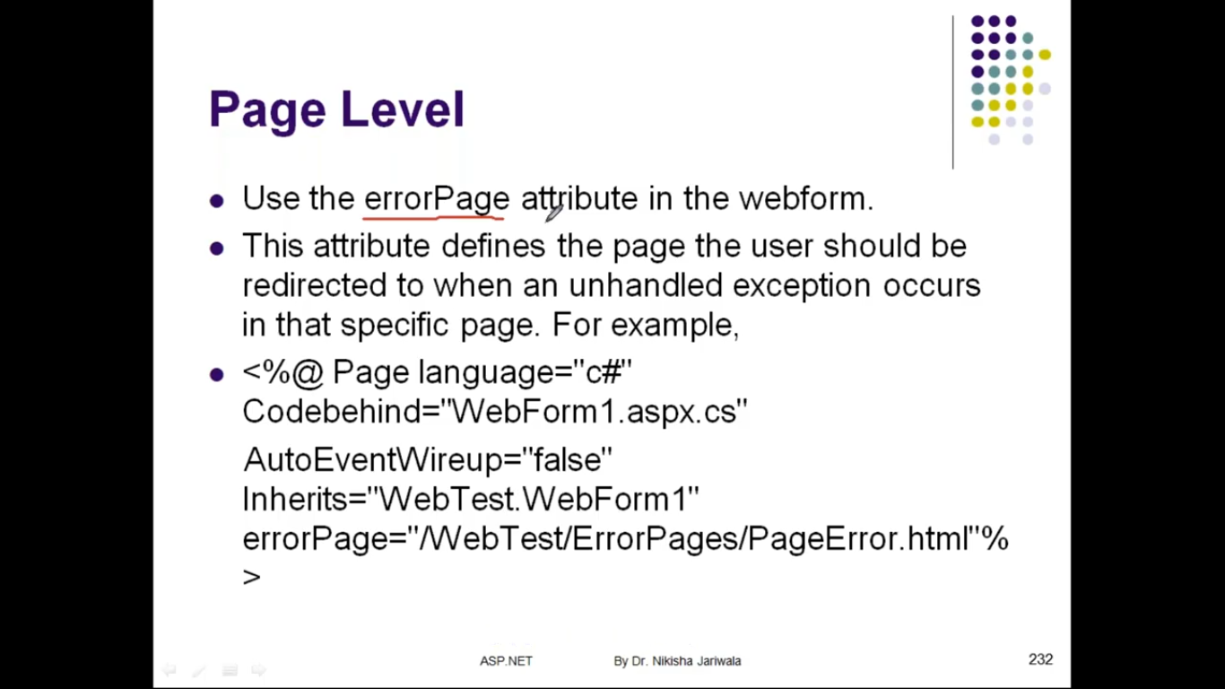

Slide 23
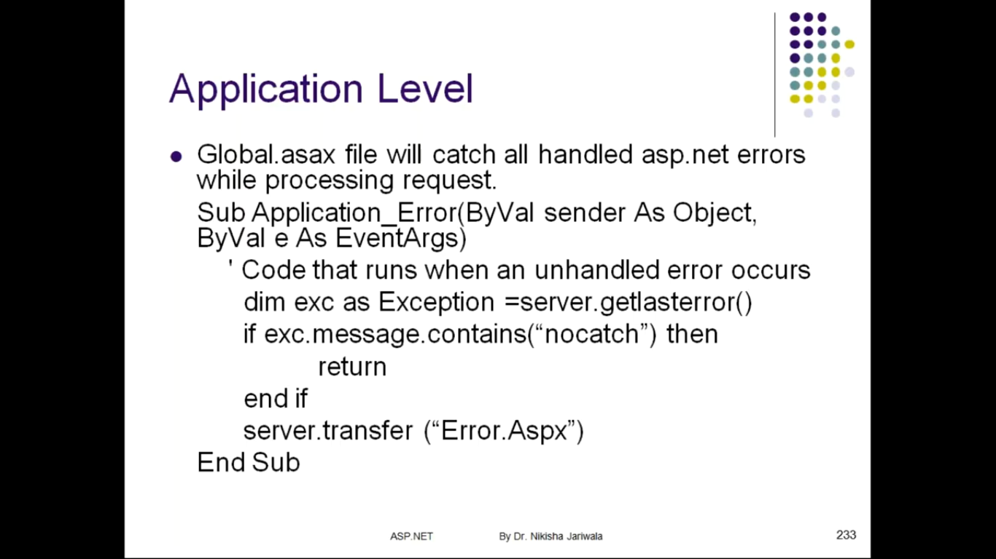

Slide 24
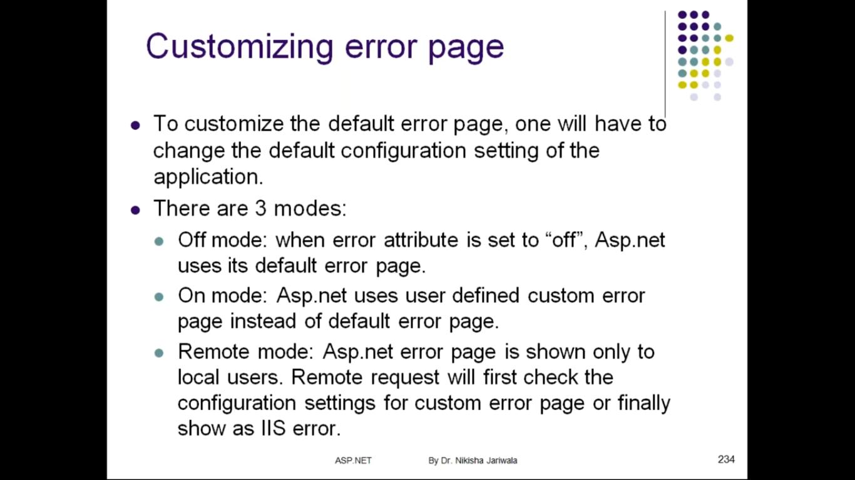

Slide 25


Slide 26


Slide 27


Slide 28
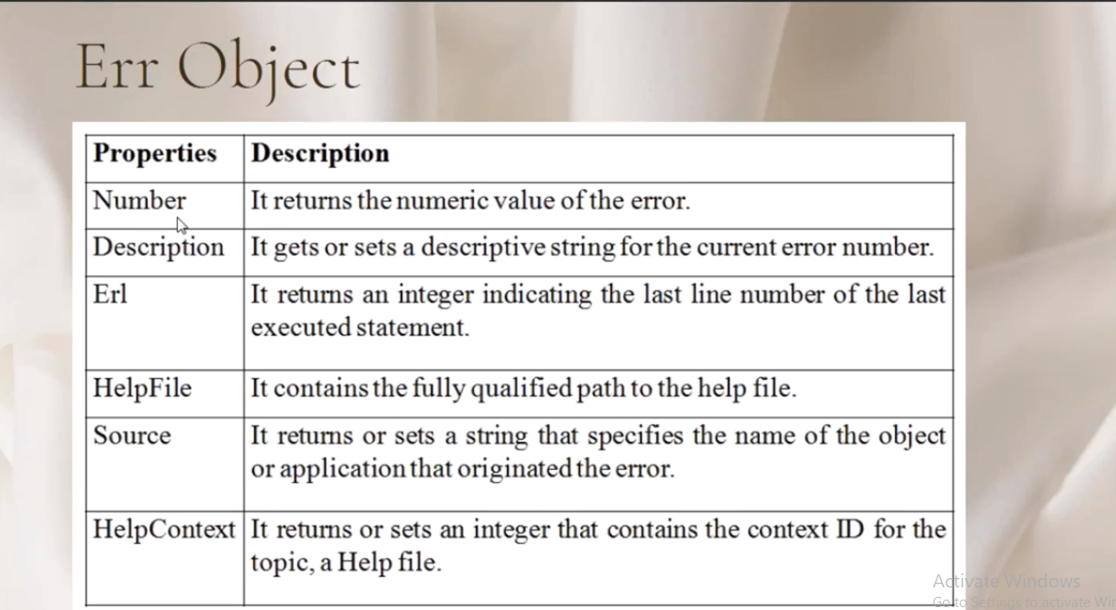

Slide 29
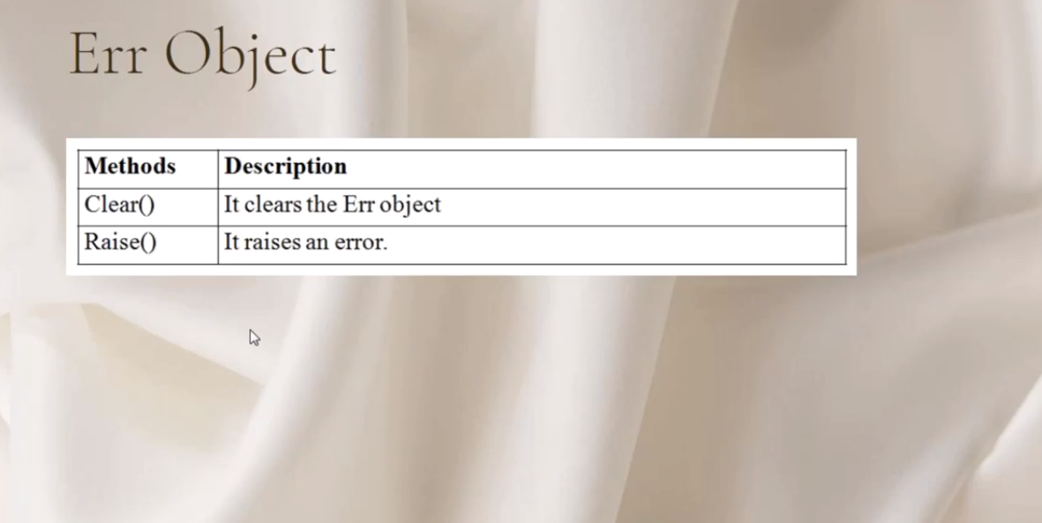

Slide 30
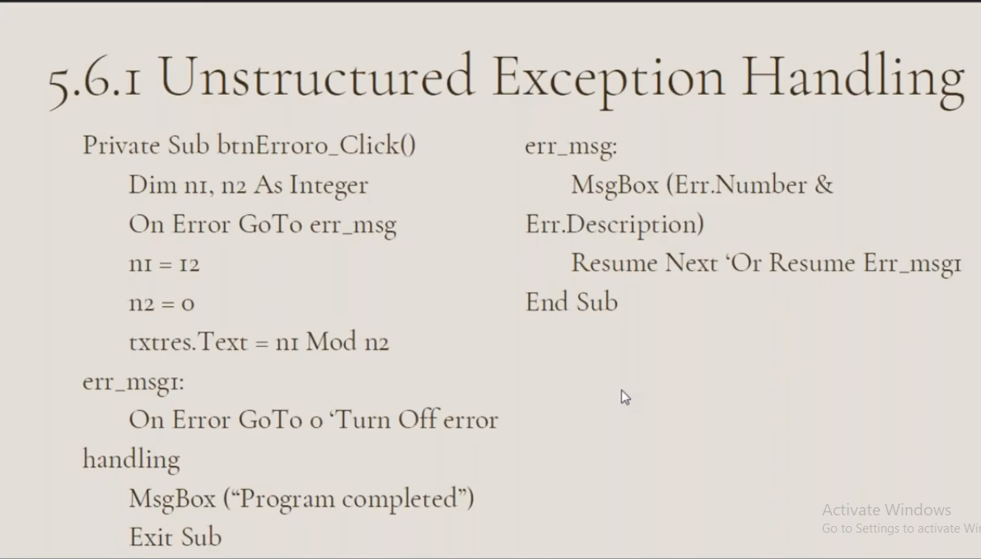

Slide 31
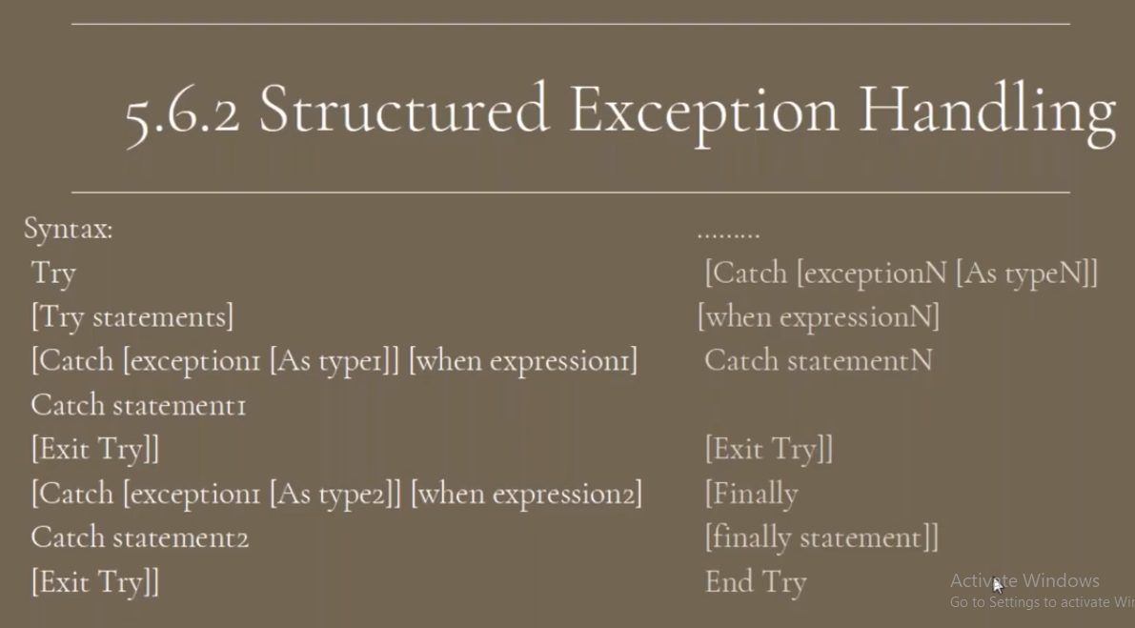

Slide 32
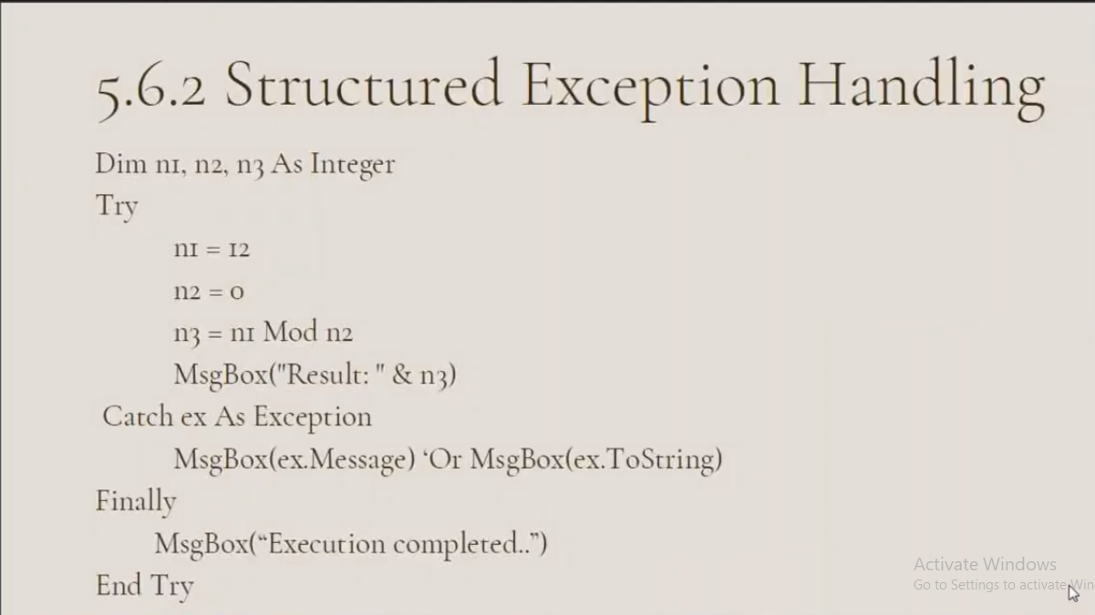

Slide 33
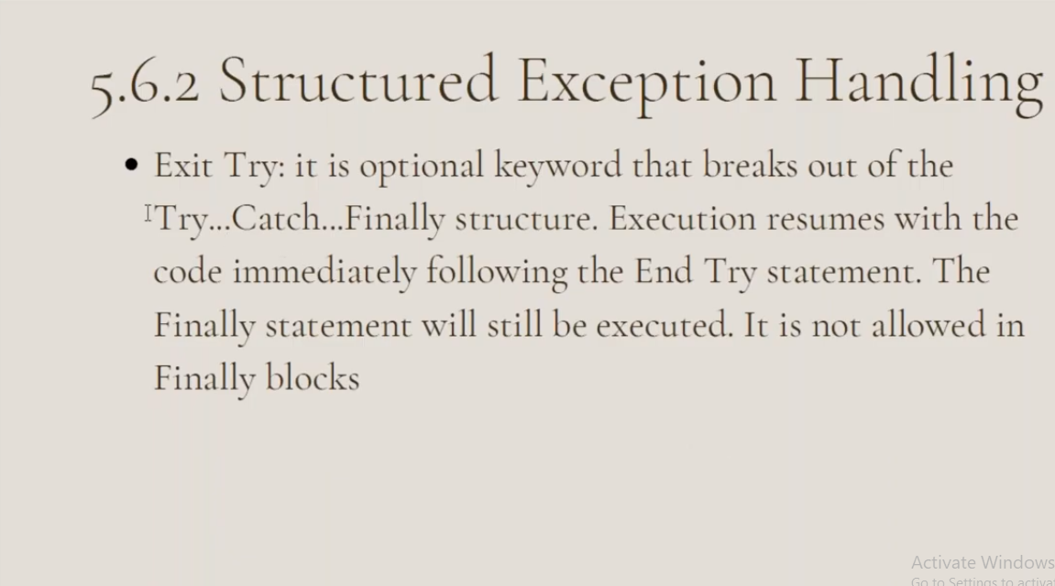

Slide 34


